Slide 1
DEVELOPMENT CONTINUOS DELIVERY PIPELINE
Name - Parth Rai
Course - B.tech CS(Devops)
Roll no - 42

Slide 2
What Does Mean By Word 'Development'??
1) The systematic use of scientific and technical knowledge to meet specific objectives or requirements.
OR
2) An extension of the theoretical or practical aspects of a concept, design, discovery, or invention.

Slide 3
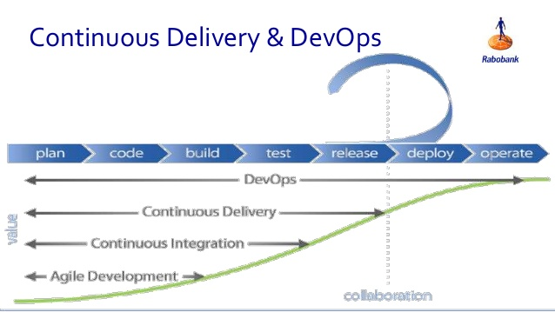
What is Meant by Continuos Delivery?
Continuous delivery (CD) is a software engineering approach in which teams produce software in short cycles, ensuring that the software can be reliably released at any time.

Slide 4
What you understand from the word PIPELINE?
A Pipeline product is a series of products, either in a state of development, preparation, or production, developed and sold by a company, and ideally in different stages of their life cycle.
The Pipeline breaks down the software delivery into small stages.The Pipeline should provide feedback to the team and visibility into the flow of changes to everyone involved in delivering the new feature.

Slide 5
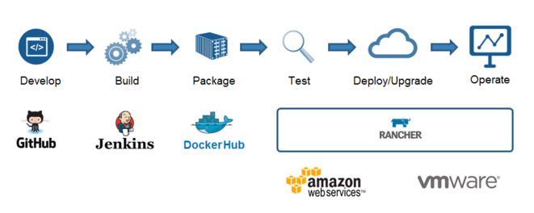
CYCLE OF DEVOPS PIPELNE

Slide 6
Benefits of Defining PIPELINE
Knowing what you have
Knowing what you don't have
Knowing your bottleneck
Seeing your whole operation in one place
And finally having an opportunity to improve.

Slide 7
There are especially three stages to complete the Devops Delivery Pipeline....
BUILD AUTOMATION
UNIT TEST AUTOMATION
DEPLOYMENT AUTOMATION

Slide 8
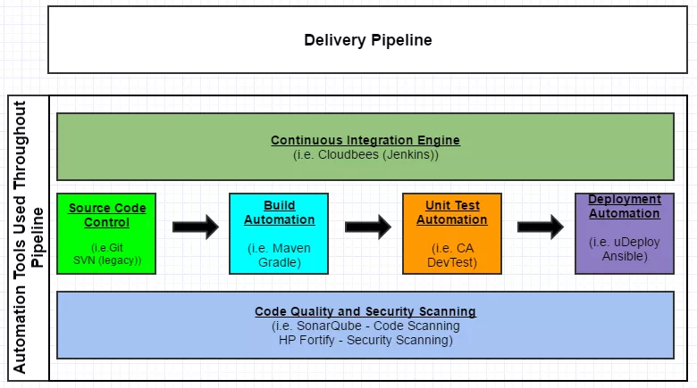
OVERVIEW OF DEVOPS DELIVERY PIPELINE

Slide 9
Source Code Controller
Source Code Control System is a version control system designed to track changes in source code and other text files during the development of a piece of software. This allows the user to retrieve any of the previous versions of the original source code and the changes which are stored.

Slide 10
Source Code Controller Tools
GIT - Git is a version-control system for tracking changes in computer files and coordinating work on those files among multiple people.It is primarily used for source code management but can keep track of changes in any set of files.
SVN -Svn is a source and version control tool which is used to create your own repository and perform all related svn operations.

Slide 11
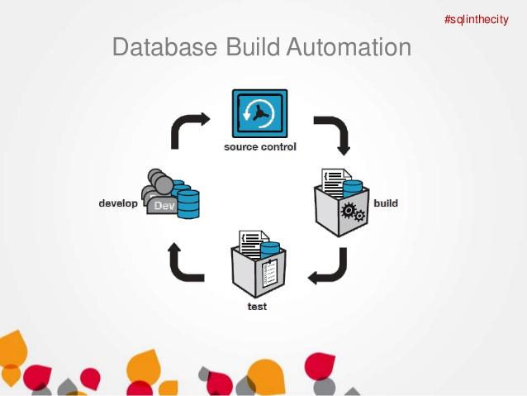
BUILD AUTOMATION
Build automation is the process of automating the creation of a software build and the associated processes including: compiling computer source code into binary code, packaging binary code, and running automated tests.

Slide 12
BUILD AUTOMATION TOOLS
MAVEN - Maven is a build automation tool used primarily for Java projects. Maven addresses two aspects of building software: First, it describes how software is built, and second, it describes its dependencies.
GRADLE - Gradle is an open-source build automation system that builds upon the concepts of Apache Ant and Apache Maven and introduces a Groovy-based domain-specific language (DSL) instead of the XML form used by Apache Maven for declaring the project configuration.

Slide 13
ADVANTAGES OF BUILD AUTOMATION
To save time and Money
Improve Product Quality
Eliminate the Redundant Task
Accelerate the link and compile processing

Slide 14
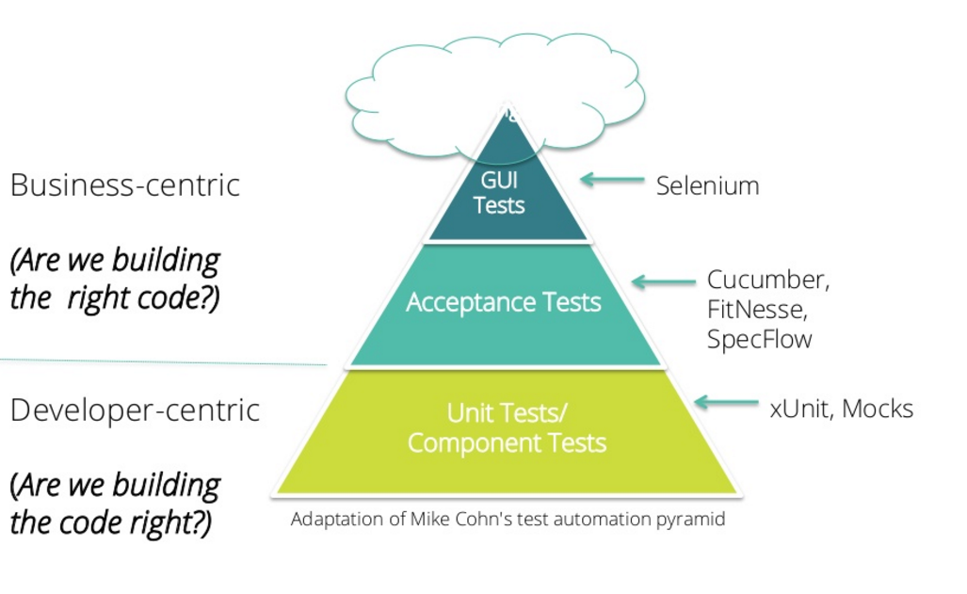
UNIT TEST AUTOMATION
Unit testing is a software development process in which the smallest testable parts of an application, called units, are individually and independently scrutinized for proper operation. Unit testing can be done manually but is often automated.

Slide 15
ACCEPTANCE TEST - ACCEPTANCE TESTING is a level of software testing where a system is tested for acceptability. The purpose of this test is to evaluate the system's compliance with the business requirements and assess whether it is acceptable for delivery.
GUI TEST - GUI testing is the process of testing the system's Graphical User Interface of the Application Under Test. GUI testing involves checking the screens with the controls like menus, buttons, icons, and all types of bars - toolbar, menu bar, dialog boxes and windows, etc. GUI is what user sees.

Slide 16
UNIT TESTING TOOLS
J UNIT - JUnit is a unit testing framework for the Java programming language.
N UNIT - NUnit is an open-source unit testing framework for Microsoft .NET. It serves the same purpose as JUnit does in the Java world, and is one of many programs in the xUnit family.

Slide 17
BENEFITS OF UNIT TESTING
It improves the code quality.
Find Software Bugs earlier(before integration testing also).
Debugging process- if the test fails, then only the latest changes made in the code is to be debugged.
It makes the process agile

Slide 18
DEPLOYMENT AUTOMATION
Continuous Deployment is the practice of continuously pushing to production new versions of software under development. Model-Driven Deployments — Model Driven Deployments help organizations automate complex deployments, in order to speed up releases and increase software quality.

Slide 19
TOOLS
JENKINS - Jenkins has become the open source standard for managing the dev side of devops, from source code management to delivering code to production. ... Jenkins is a continuous integration (CI) and continuous delivery (CD) solution.
DOCKER - Docker is a tool which is used at deployment stage for containerization of an application so that the application can work efficiently in different environment. It is a very important tool which is used in DevOps.

Slide 20
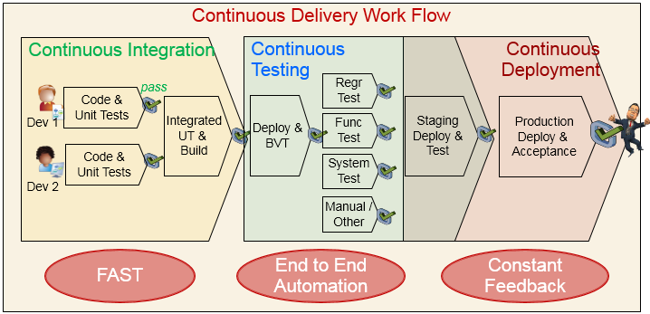

Slide 21
BVT - It is known as Build verification test . It is a set of test run on every new build to verify that build is testable before it is released to test team for further testing. It is also a automated process.
Regr test -
Regression Testing is defined as a type of software testing to confirm that a recent program or code change has not adversely affected existing features.
Regression Testing is nothing but full or partial selection of already executed test cases which are re-executed to ensure existing functionalities work fine.

Slide 22
SYSTEM TEST - System testing provides an effective means to verify that the software and its supporting environment behaves as expected to your functional and non-functional requirements
FUNCTION TEST - Functional testing focuses on testing the interface of the application to ensure that all user requirements for a properly working application are met.

Slide 23
NFRS
NON FUNCTIONAL REQUIREMENTS -The specification of system qualities such as ease-of-use, clarity of design, latency, speed, ability to handle large numbers of users etc. that describe how easily or effectively a piece of functionality can be used, rather than simply whether it exists. These characteristics can also be addressed and improved using the Continuous Delivery feedback loop.

Slide 24
BENEFITS OF DEPLOYMENT AUTOMATION
Improve overall productivity.
Automate the repetitive tasks and focus on actual testing.
Provide a single view across all applications and environments.

Slide 25
THANK YOU

